Slide 1
Zoom into Big Data: MLOps in action
D. A. Tamburri, Ph.D.

Slide 2
Outline
A Case for MLOps
MLOps Lifecyle and Architecture
Key MLOps Components and Requirements

Slide 3

Bringing ML/AL Models into Production: Reality
Fast, Reliable, Automated, Continuous
Model Development
(Development Environment)
Model Deployment
(Production Environment)
What is the probability of a successful model deployment?
87% fail (VentureBeat)
85% fail (Gartner)
22% success (Algorithmia)
20% success (KDnuggets)
etc.

Slide 4
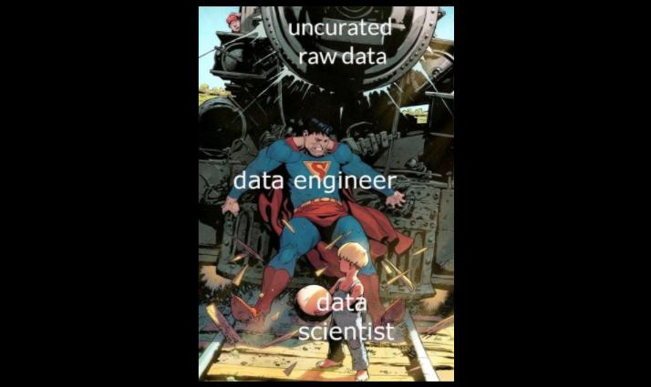

Slide 5
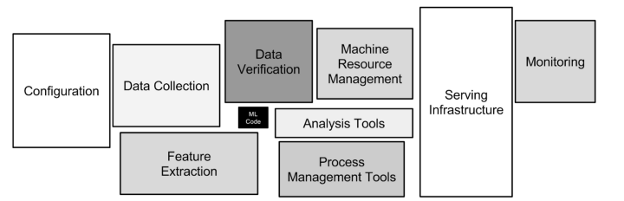
Bringing ML/AI Models into Production: Why Fail?
Machine learning projects are much more than models and algorithms (much more complex).
Source: Hidden Technical Debt in Machine Learning Systems
https://proceedings.neurips.cc/paper/2015/file/86df7dcfd896fcaf2674f757a2463eba-Paper.pdf from Google research
This paper highlights the challenges of real-world machine learning systems and triggers the MLOps movement.
Notes:
In software development, technical debt is the implied cost of additional rework caused by choosing an easy solution now instead of using a better approach that would take longer. Analogous with monetary debt, if technical debt is not repaid, it can accumulate "interest", making it harder to implement changes.
Technical debt (also known as tech debt or code debt) describes what results when development teams take actions to expedite the delivery of a piece of functionality or a project which later needs to be refactored

Slide 6
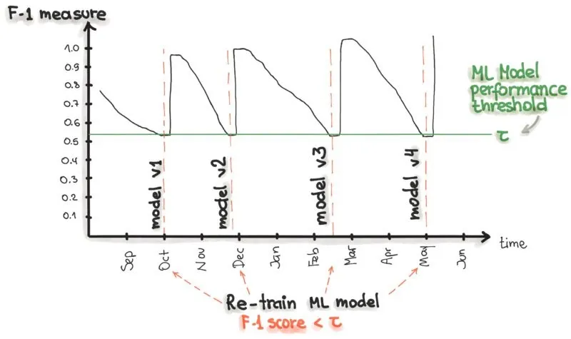
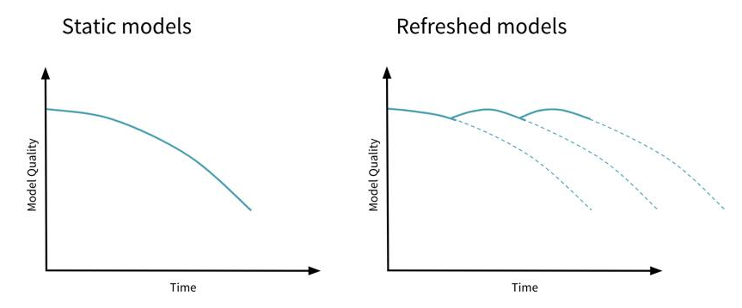
Bringing ML/AI Models into Production: Why Fail?
After deploying the model into production, the model starts to decay and to behave abnormally.
Source: https://neptune.ai/blog/retraining-model-during-deployment-continuous-training-continuous-testing
Source: https://www.oreilly.com/radar/lessons-learned-turning-machine-learning-models-into-real-products-and-services/
Source: https://www.databricks.com/blog/2019/09/18/productionizing-machine-learning-from-deployment-to-drift-detection.html

Slide 7

Bringing ML/AI Models into Production: Solution?
Fast, Reliable, Automated, Continuous
Model Development
(Development Environment)
Enable!
Model Deployment
(Production Environment)
Practices and Methodologies
Technologies and Tools
Teams with Relevant Skills
MLOps

Slide 8
MLOps Definition(s)
MLOps or ML Ops is a set of practices that aims to deploy and maintain machine learning models in production reliably and efficiently. Source: Wikipedia
The extension of the DevOps methodology to include Machine Learning and Data Science assets as first-class citizens within the DevOps ecology. Source: MLOps SIG
MLOps is a set of standardized processes and technology capabilities for building, deploying, and operationalizing ML systems rapidly and reliably. Source: Google Inc.
An optimal MLOps experience [as] one where Machine Learning assets are treated consistently with all other software assets within a CI/CD environment. Machine Learning models can be deployed alongside the services that wrap them and the services that consume them as part of a unified release process. Source: MLOps SIG
Continuous Delivery for Machine Learning (CD4ML) is a software engineering approach in which a cross-functional team produces machine learning applications based on code, data, and models in small and safe increments that can be reproduced and reliably released at any time, in short adaptation cycles. Source: Thoughtworks

Slide 9
Notebooks vs Automated ML Pipelines
ML training process takes data and code as input and produces a trained ML model as the output.
We can use Notebooks to implement a training process.
  Easy to write ML code, experiment, and visualize the results
However, to automate the execution of a training process and to use complex computing environments (e.g., Kubernetes cluster, HPC cluster, or VM cluster), we need to implement the training process as an independently executable workflow.
  There are ML pipeline/workflow engines that can execute ML pipelines/workflows.
    e.g., AWS SageMaker, Vetext AI, Kubeflow, Dagster, ZenML , Prefect, Netflix Genie
  We can trigger ML pipelines on demand, on a schedule, or in response to specified events (i.e., continuous training).
Fortunately, we can combine Notebooks and executable ML pipelines (e.g., with Vertex AI)
  Use a notebook environment to develop executable ML pipelines.
Common Problems with Creating Machine Learning Pipelines from Existing Code
https://storage.googleapis.com/pub-tools-public-publication-data/pdf/b50bc83882bbd29c50250d1e59fbc3afda3fb5e5.pdf

Slide 10
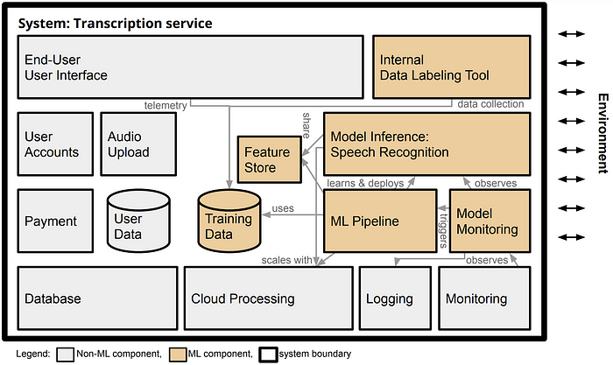
ML Models vs ML-enabled systems
ML-enabled systems consist of ML components and non-ML components.
  The models do not operate in silos; they are components of, and support, a large range of application systems, such as business intelligence systems, line of business applications, process control systems, and embedded systems. [Google]
  In production systems, machine learning is almost always used as a component in a larger system. [1]
[1] Architectural Components in ML-Enabled Systems https://ckaestne.medium.com/architectural-components-in-ml-enabled-systems-78cf76b29a92
Notes:
https://ieeexplore.ieee.org/document/8327042
In the transcription service startup from the previous chapter, machine learning provides the very core functionality of the system that converts uploaded audio files into text. Yet, to turn the model into a product, many other (usually non-ML) parts are needed, such as (a) a user interface to create user accounts, upload audio files, and show results, (b) a data storage and processing infrastructure to queue and store transcriptions and process them at scale, (c) a payment service, and (d) monitoring infrastructure to ensure the system is operating within expected parameters.

Slide 11
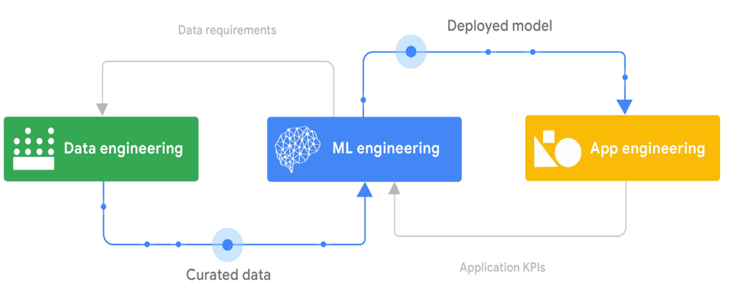
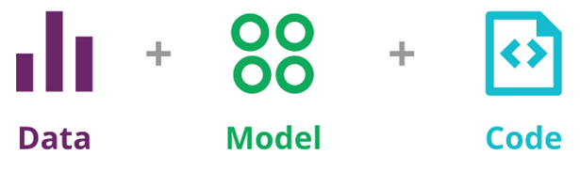
ML Models vs ML-enabled systems (Cont’d)
Changes (e.g., a new feature and bugfix) can happen at data, model, and code levels.
Building an ML-enabled system is a multifaceted undertaking that combines data engineering, ML engineering, and application engineering tasks (a cross-functional team).
Source: Practitioners guide to MLOps: A framework for continuous delivery and automation of machine learning. Google
Source: https://martinfowler.com/articles/cd4ml.html

Slide 12
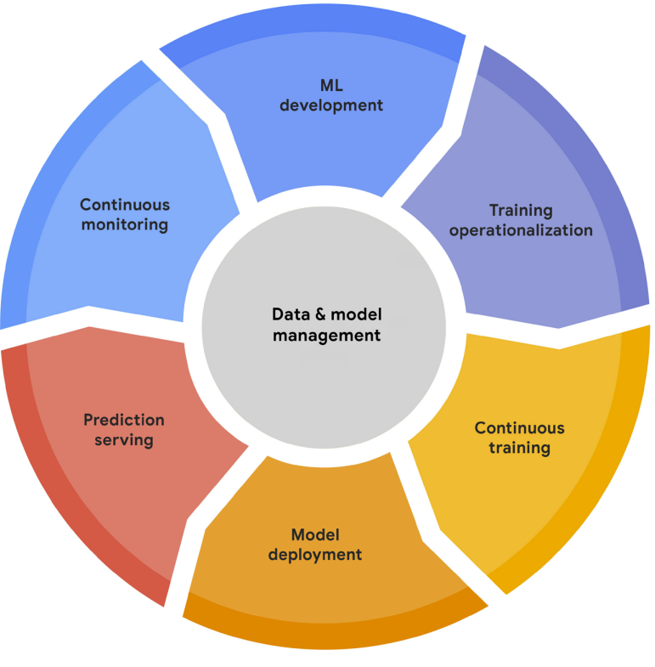
MLOps Lifecycle
ML development – build executable, reproducible training pipelines
Training operationalization – CI-CD pipelines for packaging, testing, and deploying pipelines
Continuous training – automated execution of pipelines in response to various triggers
Model deployment – CI-CD pipelines for packaging, testing, and deploying the serving app
Prediction serving – provide the inferences from the model in production (via the serving app)
Continuous monitoring – monitor model performance and data quality
Data and model management – store, manage, and govern raw data, features, models, and other ML artifacts.
Source: Practitioners guide to MLOps: A framework for continuous delivery and automation of machine learning. Google
Notes:
ML development concerns experimenting and developing a robust and reproducible model training procedure (training pipeline code), which consists of multiple tasks from data preparation and transformation to model training and evaluation. • Training operationalization concerns automating the process of packaging, testing, and deploying repeatable and reliable training pipelines. • Continuous training concerns repeatedly executing the training pipeline in response to new data or to code changes, or on a schedule, potentially with new training settings. • Model deployment concerns packaging, testing, and deploying a model to a serving environment for online experimentation and production serving.

Slide 13
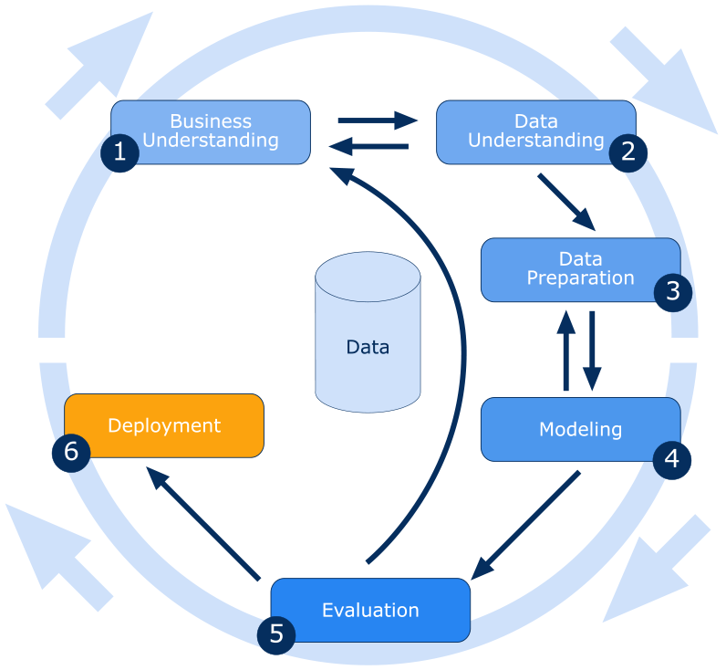
Which is a tailoring of CRISP-DM ☺

Slide 14
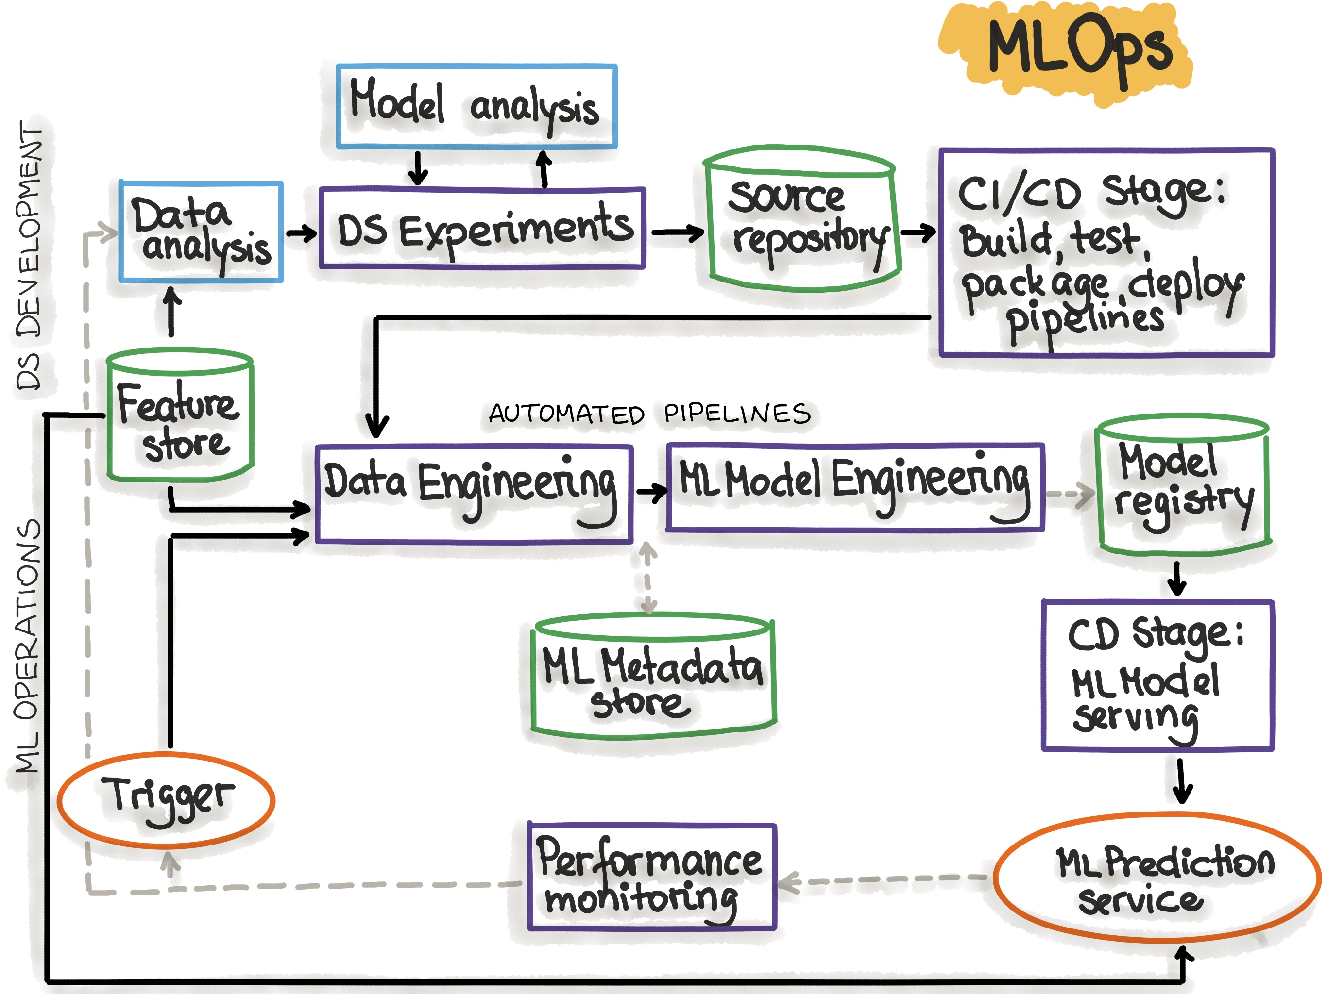
An MLOps Architecture Blueprint (Simplified)
Can you map the MLOps Life stages to the architecture components in this blueprint?
ML development
Training operationalization
Continuous training
Model deployment
Prediction serving
Continuous monitoring
Data and model management
CI also is relevant hee
source: https://ml-ops.org/content/mlops-principles
DS – Data Science

Slide 15
Model Development and Evolution
Why do we need to store executable ML pipelines?
Problem Definition
Experiment Notebooks and
Executable Training Pipelines
Model Validation
Data Selection
Raw data store
Model Prototyping
Data Exploration
Version Control System
What metadata should be recoded?
Why do we need to record experiment metadata (experiment tracking)?
Feature store
Feature Engineering
Models
Metadata and artifacts of the
experiments
Model Registry
ML Metadata and Artifact Store
Source: Practitioners guide to MLOps: A framework for continuous delivery and automation of machine learning. Google
Notes:
The CRoss Industry Standard Process for Data Mining (CRISP-DM)

Slide 16
Model Development and Evolution (Cont’d)
Experiment tracking saves all experiment-related information in a database and allows query and interactive exploration of the information.
Why do we need experiment tracking?
  Reproduce, re-run, share, reuse, and compare experiments
  Debug model training and auditing models
What should we record?
  Training Parameters
    Hyperparameters, model architectures, training algorithms, train-validation-test splits
  Model Metrics
    Training and evaluation accuracy, loss
  Other Metadata
    Training source code location (e.g., the revision number and the GitHub URL), data versions, experiment names, training Job parameters (CPU, GPU and instance type), artifact locations (e.g., Google bucket name), etc.
Source: Practitioners guide to MLOps: A framework for continuous delivery and automation of machine learning. Google

Slide 17
Model Development and Evolution (Cont’d)
Feature Store
  Store and manage features (produced by feature engineering pipelines).
    It enables the reuse of features.
  Various model training pipelines and prediction applications use the features from the feature store.
Model Store
  Stores ML models, including their versions and metadata.
  Enable easy discovery, sharing, and governance of models.
Metadata Store
  Store various types of metadata (e.g., database schemas, ML pipeline parameters, data source information, evaluation metrics, etc.).
  Enable easy discovery of data, reconfigurability of pipelines, governance of data/models/pipelines/etc.
Notes:
https://towardsdatascience.com/the-only-3-ml-tools-you-need-1aa750778d33

Slide 18
Model Development and Evolution (Cont’d)
Outputs form the experimentation stage can include:
  Candidate models (stored in the model registry)
  Implementation of the continuous training pipeline (pipeline configuration/model and source code, stored in a versioned control system)
    If we need to retrain ML models on a regular basis, we need the pipelines that can produce models.

Slide 19
(Re-)Training Operationalization
CI-CD Trigger
CD
Production Deployment
CI
Deploy to Staging
Production
Code and Config
Build
Smoke Tests
Acceptance Testing
Pipelines
Integration Testing
Staging
Release
Version Control
System
Deploy to Production
ML Pipeline Engines
What are the common CI-CD triggers?
Pipeline Components
(e.g., Docker Images)
Artifact Store
Source: Practitioners guide to MLOps: A framework for continuous delivery and automation of machine learning. Google
Notes:
In the CI stage, the source code is unit-tested, and the training pipeline is built and integration-tested. Any artifacts that arecreated by the build are stored in an artifact repository.
In the CD stage, the tested training pipeline artifacts are deployed to a target environment, where the pipeline goes through end-to-end testing before being released to the production environment. Typically, pipelines are tested in non-production environments on a subset of production data, while the full-scale training is performed only in production environments.
The newly deployed training pipeline is smoke-tested. If the new pipeline fails to produce a deployable model, the model serving system can fall back to the model that was produced by the current training pipeline.

Slide 20
Automated (Continuous) Training
What are the common Re-training triggers?
Re-training Trigger
Metadata Store
Artifact Store
Continuous Training Pipeline
Data Loading and Processing
Model Validation
Model Evaluation
Models
Raw Data Store
Feature Engineering
Model Training
Model Registration
Model Registry
Feature Store
Data Processing Engine
ML Training Engine
Model Evaluation Engine
Source: Practitioners guide to MLOps: A framework for continuous delivery and automation of machine learning. Google
Notes:
The continuous training process is about orchestrating and automating the execution of training pipelines.

Slide 21
Automated (Continuous) Training (Cont’d)
Trigger Types
  On demand: Ad-hoc the manual execution of the pipeline.
  Scheduled
    The models are retrained periodically, according to a schedule (e.g., daily, weekly, or monthly).
  Event-driven
    An event indicates a change in the MLOps environment. e.g., updating the source code in the GitHub repository and adding a new feature set to the feature store.
  Metric-based
    Some metrics are monitored and used to determine if re-retraining is necessary. e.g., model performance metrics and data quality metrics.

Slide 22
Automated (Continuous) Training (Cont’d)
Trigger Types
  On demand: Ad-hoc the manual execution of the pipeline.
  Scheduled
    The models are retrained periodically, according to a schedule (e.g., daily, weekly, or monthly).
  Event-driven
    An event indicates a change in the MLOps environment. e.g., updating the source code in the GitHub repository and adding a new feature set to the feature store.
  Metric-based
    Some metrics are monitored and used to determine if re-retraining is necessary. e.g., model performance metrics and data quality metrics.
66%
24%
<4%
~6%
Can we combine Metric-based and Event-driven?

Slide 23
Automated (Continuous) Training (Cont’d)
Assign the best retraining strategy for the following use cases:
  A student attrition model that predicts whether a student will return the following semester. The predictions are made on the current cohort of students directly after midterms.
  A stock price predictor model that continuously predict the future value of a stock traded on a stock exchange for getting profits.
  The new (automated) ethical standard tests for a facial recognition model detected the use of sensitive personal data without anonymizing them. A new model needs to be retrained by properly preserving data privacy.
  For a sentiment prediction model, a new tweets dataset is collected and made available in the source databases.
Schedule
Metrics
Event/Manual
Event
Notes:
https://mlinproduction.com/model-retraining/
https://learn.microsoft.com/en-us/azure/architecture/example-scenario/ai/student-attrition-prediction

Slide 24
Model Deployment
Artifact Registry
Version Control
System
Re-deployment Trigger
Serving App Code
Test
Build Serving App Image
Register Image
Deploy Model Serving App Image
Model Deployment CI-CD Pipeline
Model Registry
What are the common re-deployment triggers?
What are things we need to consider before starting the deployment?
Source: Practitioners guide to MLOps: A framework for continuous delivery and automation of machine learning. Google and
https://cloud.redhat.com/blog/enterprise-mlops-reference-design
Notes:
When deploying systems you need to check certain items and how robust is your deployment strategy to deal with these items:
Is there already an existing model in production that will be replaced?
If there is a bug in the new deployment, Is there a quick and applicable rollback plan?
if my model doesn’t reach the required accuracy in production , how huge is the negative consequences , and what is the best strategy to minimize them?
How Fast will the new model be rolled out?

Slide 25
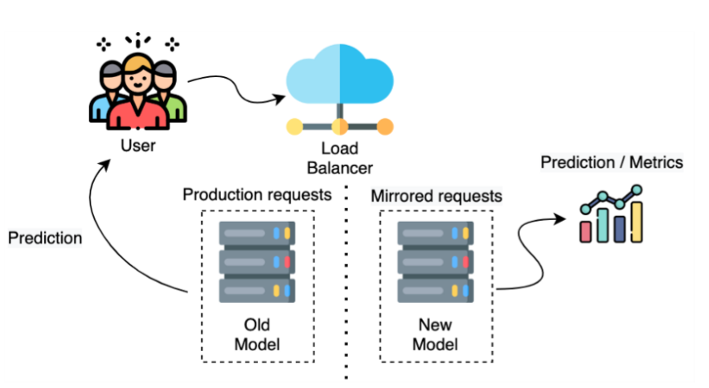
Model Deployment : Deployment Strategies
The new model (called the shadow model) is deployed alongside the old live model.
Duplicate the requests and send all production traffic to both models
However, the predictions from the new model are not used to service end-users.
Predictions from the new model are used to compare it with the old model.
If the new model is good enough to replace the old one, we can redirect user traffic to the new model (or use both models in parallel)
Shadow Deployment
source: https://www.linkedin.com/pulse/ml-models-deployment-strategies-kholoud-ibrahim-/?trk=articles_directory
Notes:
This strategy may use two identical environments - the old model in the original production environment and the new model in the shadow environment.

Slide 26
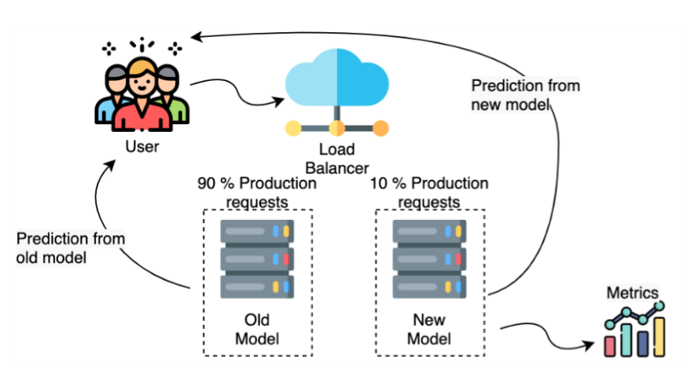
Model Deployment : Deployment Strategies (Cont’d)
Canary Deployment
Two models run in parallel
A certain user percentage is exposed to the new model.
The new model’s performance is monitored, and if the new model is good enough, its percentage of user traffic can be increased.
source: https://www.linkedin.com/pulse/ml-models-deployment-strategies-kholoud-ibrahim-/?trk=articles_directory

Slide 27
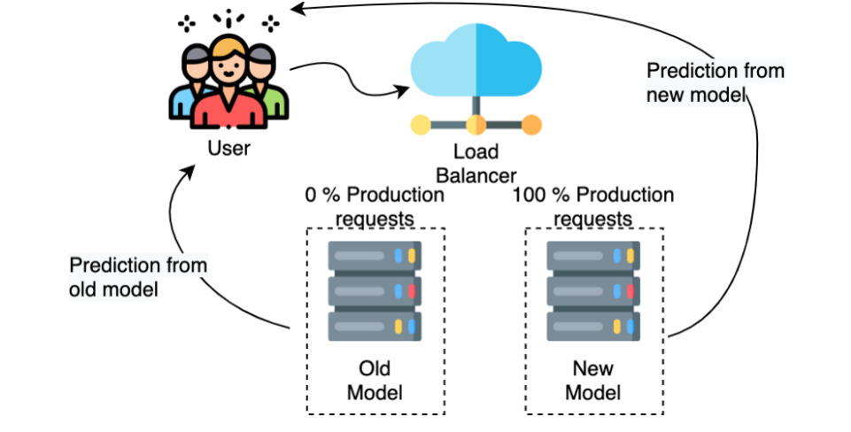
Model Deployment : Deployment Strategies (Cont’d)
Blue/Green Deployment
Two models run in parallel
Blue-green deployment strategies involve two (identical) production environments instead of just models.
Once the new model is made live, the traffic is diverted from the blue environment to the green environment completely (100%).
The blue environment can still serve as a backup.
source: https://www.linkedin.com/pulse/ml-models-deployment-strategies-kholoud-ibrahim-/?trk=articles_directory

Slide 28
Model Deployment : Deployment Strategies (Cont’d)
Criterion A: negative impacts on users due to (new) model’s failures
    Lowest -
    Highest -
Criterion B: How fast is the roll out of the new model
  Slowest -
  Fastest -
Criterion C: How fast is the rollback of the model
  No rollback necessary -
  Fast rollback -
Shadow
Blue/green
Shadow / Canary
Blue/green
Shadow
Canary/ Blue/Green

Slide 29
Model Serving
Feature Store
Serving Feature Lockup
Make Prediction
Serving Data
Model Consumer
Explain Prediction
Predictions and Explanations
Service Metrics and Request/Response Payloads
Serving Logs
Model Monitoring Engine
Source: Practitioners guide to MLOps: A framework for continuous delivery and automation of machine learning. Google
Notes:
The serving engine can serve predictions to consumers in the following forms:
Online inference in near real time for high-frequency singleton requests (or mini batches of requests), using interfaces like REST or gRPC.
Streaming inference in near real time, such as through an event-processing pipeline.
Offline batch inference for bulk data scoring, usually integrated with extract, transform, load (ETL) processes.
Embedded inference as part of embedded systems or edge devices.
In some scenarios of prediction serving, the serving engine might need to look up feature values that are related to the request. For example, you might have a model that predicts the propensity of a customer to buy a particular product, given a set of customer and product features. However, the request includes only the customer and the product identifier. Therefore, the serving engine uses these identifiers to fetch the customer and the product feature values from a feature repository and then to feed them to the model to produce a prediction.

Slide 30
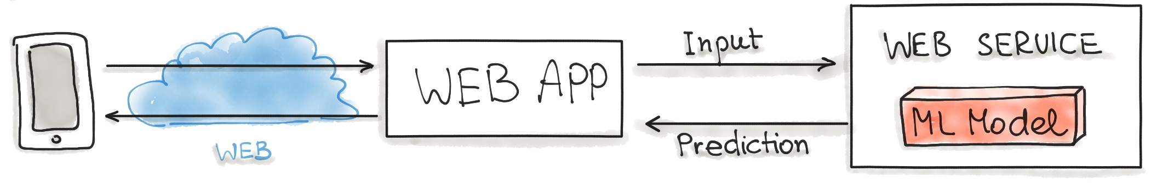
Model Serving: Design Patterns (Cont’d)
Model-as-Service/API (Online Inference)
Web Service = Web API
Can you give an example from labs?
source: https://ml-ops.org/content/three-levels-of-ml-software

Slide 31
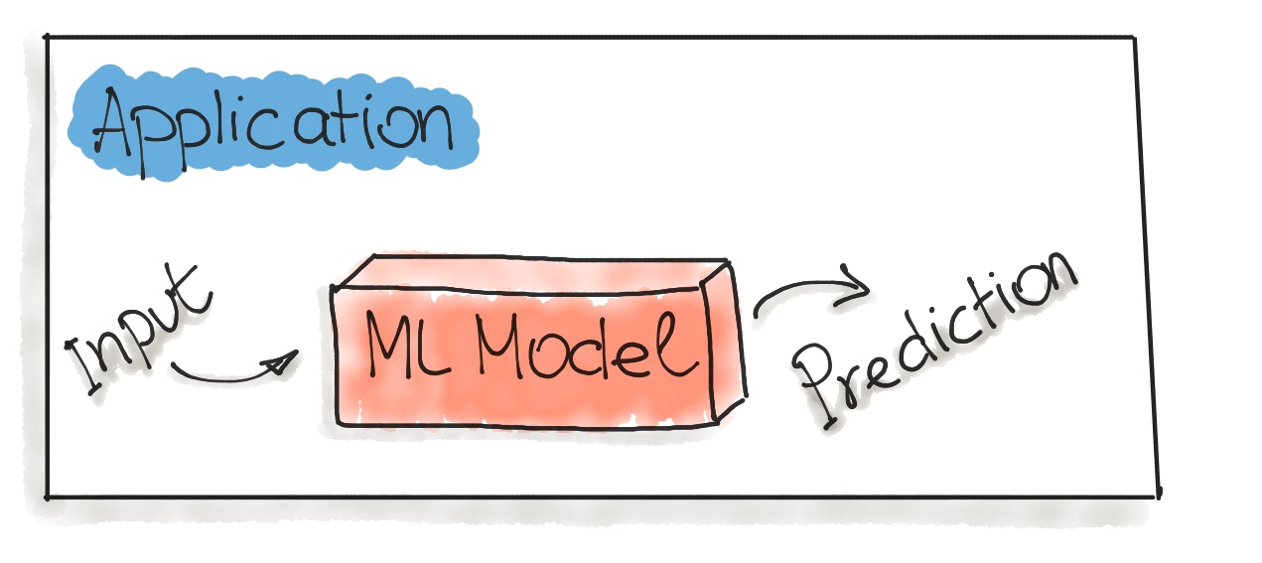
Model Serving: Design Patterns (Cont’d)
Model-as-Dependency (Online Inference)
Can you give an example from labs?
source: https://ml-ops.org/content/three-levels-of-ml-software

Slide 32
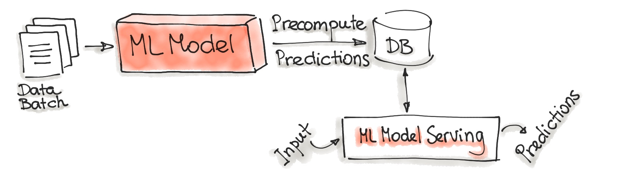
Model Serving: Design Patterns (Cont’d)
Precompute (Offline Inference)
How can we automate the precomputation of predictions?
How can the ML Model Serving component be made available to external users?
How can we apply this pattern to our Lab example?
source: https://ml-ops.org/content/three-levels-of-ml-software

Slide 33
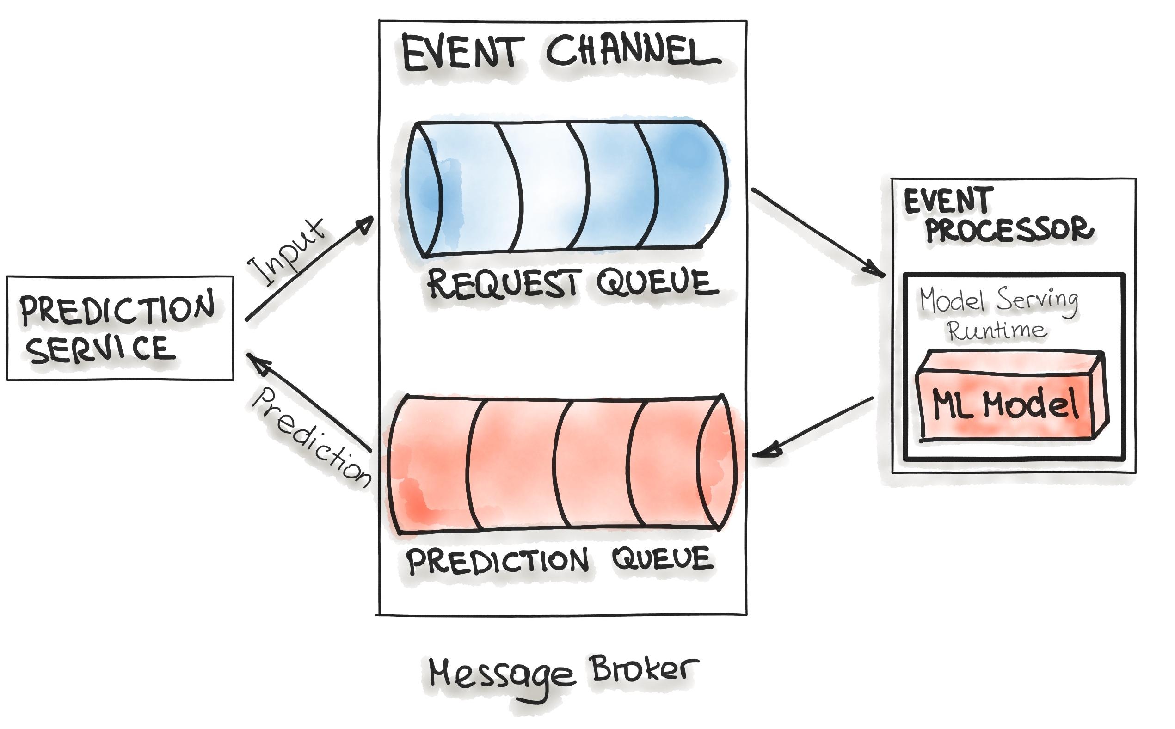
Model Serving: Design Patterns (Cont’d)
Model-On-Demand
Prediction service puts the prediction requests from the end-users at the Request Queue.
Event processor reads the requests and uses the model to make predictions.
Then, the prediction results are put in the Prediction Queue.
Prediction service can pick the prediction result messages from the queue and send them back to the end users.
source: https://ml-ops.org/content/three-levels-of-ml-software

Slide 34
Monitoring
Alerting
Triggers
Baseline stats, schemas
Data Drift Detection
ML Metadata and Artifacts Repositories
Serving Logs
Concept Drift Detection
Evaluation metrics, anomalies
Continuous Evaluation
Serving efficiency metrics
(e.g., latency, error rates, resource usage)
Labels (Ground Truth)
Data and Feature Stores
Source: Practitioners guide to MLOps: A framework for continuous delivery and automation of machine learning. Google
Notes:
A sample of the request-response payloads is captured and stored in the serving logs store.
The monitoring engine periodically loads the latest inference logs, generates a schema, and computes statistics for the serving data.
The monitoring engine compares the generated schema to a reference schema to identify schema skews, and compares the computed statistics to baseline statistics to identify distribution skews.
4. If the true labels (ground truth) for the serving data are available, the monitoring engine uses it to evaluate the model predictive effectiveness in hindsight on the serving data.
5. If anomalies are identified, or if the model’s performance is decaying, alerts can be pushed through various channels (for example, email or chat) to notify the owners to examine the model or to trigger a new retraining cycle.
In some scenarios, your system is able to store ground truth for your serving data. For example, you capture whether a customer bought a product recommended by your model, or you calculate the actual demand for a particular product by the end of the week compared to the demand that was forecasted by the model. You can use this information as true labels to your serving data, and the information can be stored and retrieved from the dataset and feature repository for continuous evaluation and for further model training cycles.
Besides monitoring model effectiveness, monitoring model serving efficiency focuses on metrics like the following:
Resource utilization, including CPUs, GPUs, and memory.
Latency, which is a key metric in online and streaming deployments to indicate model service health.
Throughput, which is a key metric in all deployments.
Error rates.
Measuring these metrics is helpful not only in maintaining and improving system performance, but also in predicting and managing costs.
28

Slide 35
Monitoring (Cont’d)
Model drift or the degradation of the model performance over time is very common. Model drift is twofold: data-drift and concept drift.
Data-drift is a variation in the production data from the data that was used to test and validate the model. Data drift can involve two types of skews:
  Schema skew occurs when training data and serving data do not conform to the same schema.
  Distribution skew occurs when the distribution of feature values for training data is significantly different from the distribution for serving data.
Concept drift is a changing relationship between the input predictors and the target variable.
What is the common solution to handling drifts?
Notes:
Concept Drift in machine learning is a situation where the statistical properties of the target variable (what the model is trying to predict) change over time. In other words, the meaning of the input data that the model was trained on has significantly changed over time, but that the model in production doesn’t know about the change and therefore can no longer make accurate predictions.
The data validation step can detect when data anomalies start occuring. These anomalies can include new features, new feature domains, features that have disappeared, and drastic changes in feature distributions. The data validation step works by comparing the new training data to the expected data schema and reference statistics.

Slide 36
Monitoring (Cont’d)
Assign Concept Drift, Schema skew, and Distribution skew to the following cases:
  Sentiment predictor. As over time people’s sentiments about the critical topics change, tweets belonging to negative sentiment may evolve over time to be positive (and vice versa).
  Weather prediction model. The model used the temperature data collected from a sensor in Celsius degrees, but the unit changed to Fahrenheit.
  Wine preference prediction model. The model was built using the attributes of Netherland wines and the preference scores from native Dutch people. Now, the wines are from France, and we need to predict the preference of French people.
  Covid risk predictor of the App. The model was mostly trained using the data from younger app users. Now, the data are available from a board user base, with a lot of older users. The model used the age as a feature.
Concept
Schema Skew
Both Types of Drifts
Distribution skew

Slide 37
Model Governance
Model Governance
Store
Evaluate
Check
Release
Report
Add/update
model properties
Compare models
Review
Deploy
Aggrege and visualize performance metrics
Track
Explain models
Approve
Rollback
Model Registry
Serving
Engine
The governance process can be automated, semi-automated, or fully automated.
Metadata and Artifact Repository
Source: Practitioners guide to MLOps: A framework for continuous delivery and automation of machine learning. Google
Notes:
Model governance can use information in the ML metadata and the model registry to do the following tasks:
Store: Add or update model properties and track model versions and property changes. The model registry can store many model versions from the experimentation and continuous training phases, which lets data scientists easily reproduce significant models.
Evaluate: Compare a new challenger model to the champion model by looking not only at evaluation metrics (accuracy, precision, recall, specificity, and so on) but also at business KPIs that are collected through online experimentation. Additionally, model owners need to be able to understand and explain the model predictions—for example, by using feature attribution methods. This ensures the quality of the model that is deployed in production.
Check: Review, request changes, and approve the model to help control for risks, such as business, financial, legal, security, privacy, reputational, and ethical concerns.
Release: Invoke the model deployment process to go live. This controls the type of the model release (for example, canary or blue-green) and the traffic split that is directed to it.
Report: Aggregate, visualize, and highlight model performance metrics that are collected from the continuous evaluation process. This ensures the quality of the model in production.
An internal framework of a firm or organization that controls the processes for model development, validation and usage, assign responsibilities and roles etc.
Who has ownership of a model?
Does a model comply with relevant regulations?
What data has a model been trained on?
What validation and approval is needed at each stage of development?
How do we monitor models post-deployment?
ML metadata tracking is generally integrated with different MLOps processes. The artifacts produced by the other processes are usually automatically stored in an ML artifact repository, along with the information about the process executions. ML metadata that is captured can include pipeline run ID, trigger, process type, step, start and end datetime, status, environment configurations, and input parameter values. Examples of artifacts that are stored include processed data splits, schemas, statistics, hyperparameters, models, and evaluation metrics or custom artifacts.

Slide 38
Model Governance (Cont’d)
Store
  Store model versions to enable model reproducibility, rollback plans, auditing, etc.
Evaluate
  Compare models using model performance metrics and business KPIs
  Explain the model predictions (feature importance and XAI)
Check
  Review and approval processes.
  Check if the model meets policy requirements (e.g., model accuracy > accuracy threshold or not bias toward a specific race)
Release
  Decide and execute model deployment strategies and rollout/rollback plans
Report
  Create various reports on model performance, etc.

Slide 39
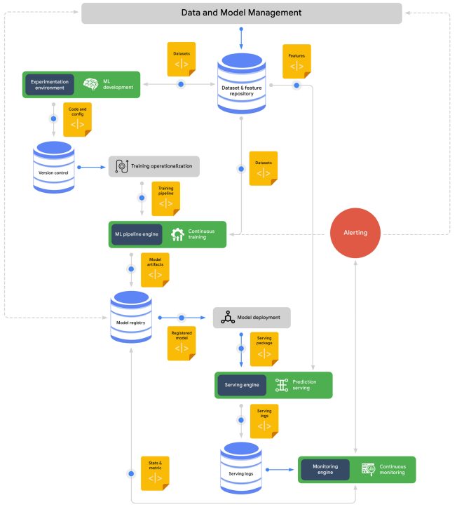

MLOps Reference Architecture : Google
https://services.google.com/fh/files/misc/practitioners_guide_to_mlops_whitepaper.pdf
Source: Practitioners guide to MLOps: A framework for continuous delivery and automation of machine learning. Google

Slide 40
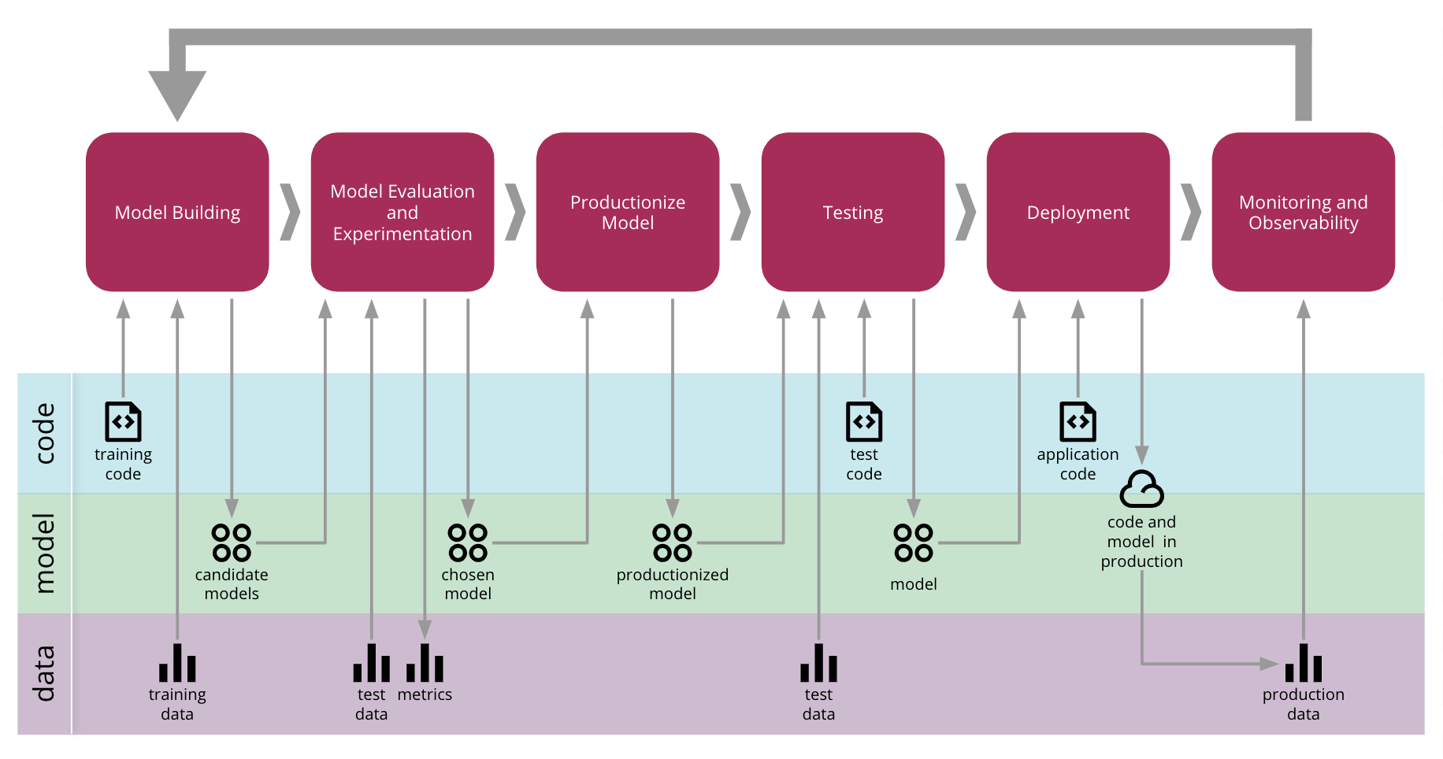
The End-to-End CD4ML Process from Thoughtworks
Source: https://martinfowler.com/articles/cd4ml.html

Slide 41
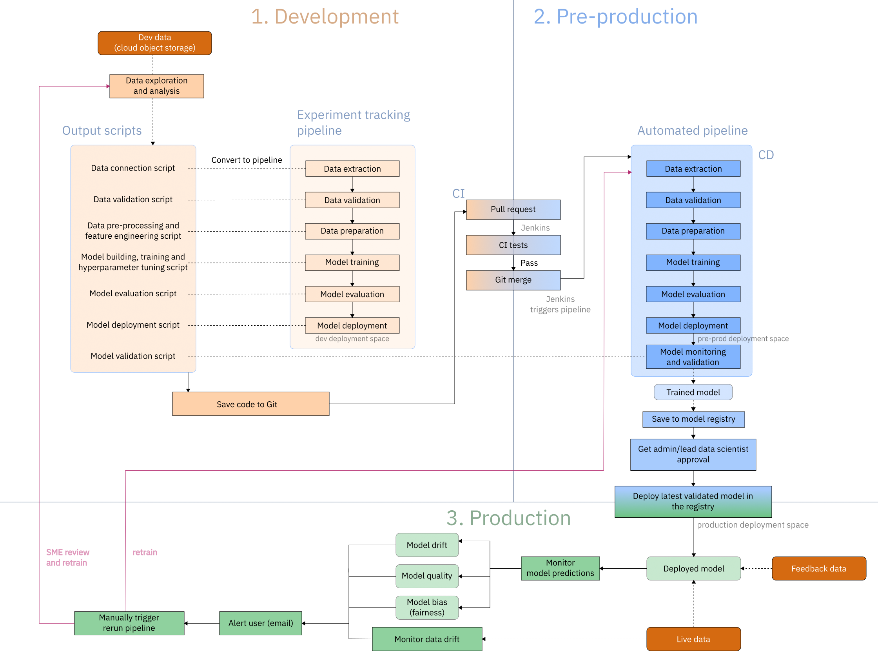
Architecture of the MLOps flow : IBM
https://github.com/IBM/MLOps-CPD

Slide 42
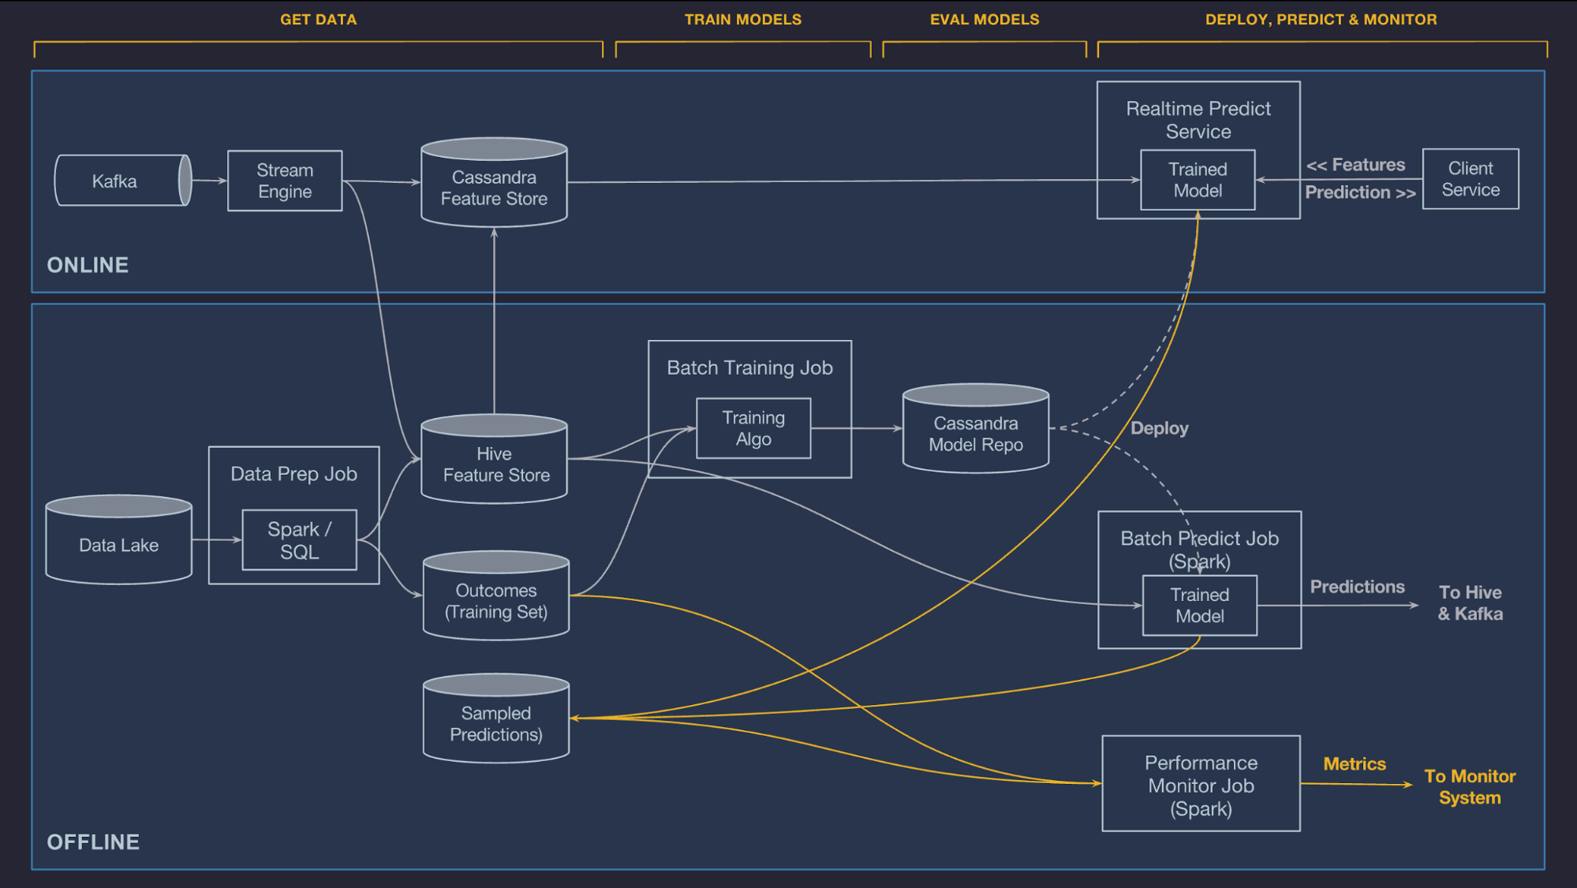
The second part of the course covers batch and stream data ingestion and processing (Kafka and Spark).
Michelangelo: Uber’s Machine Learning Platform
https://www.uber.com/en-NL/blog/michelangelo-machine-learning-platform/

Slide 43
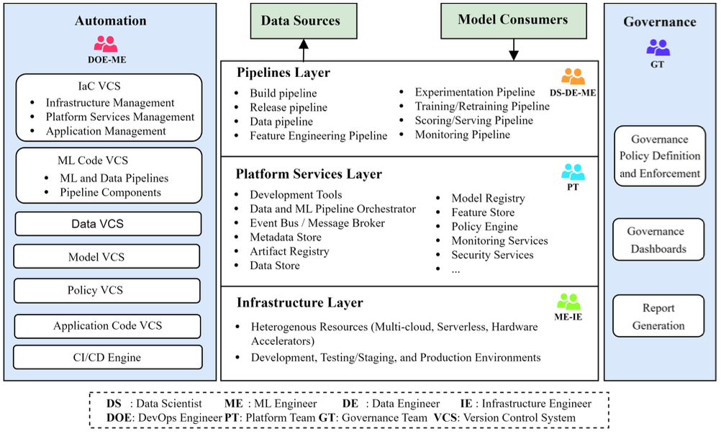
A more Academic Tale* …
*

Slide 44
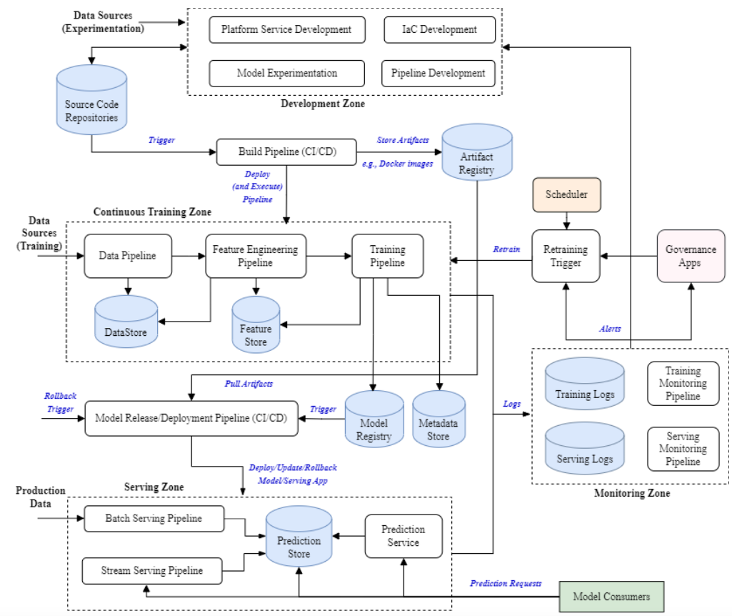

Slide 45
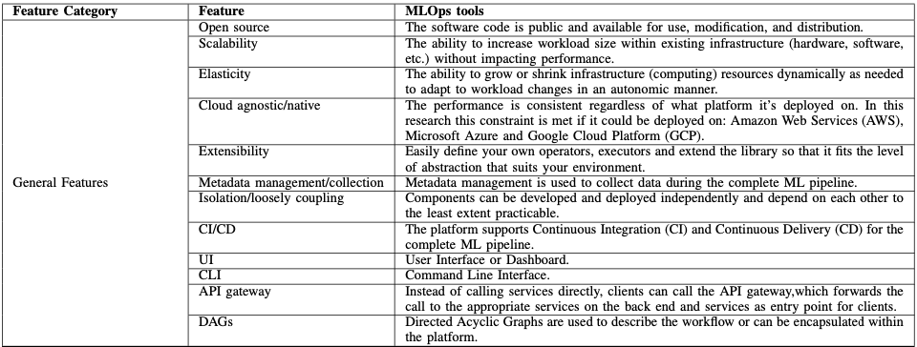
Also, Tools and features…

Slide 46
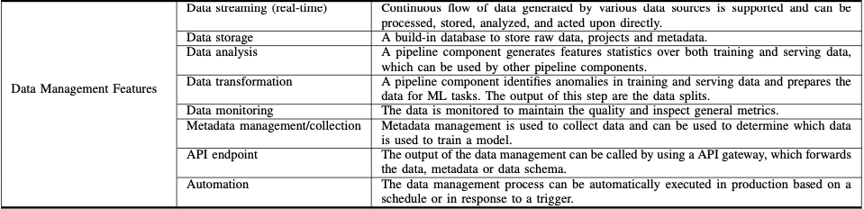
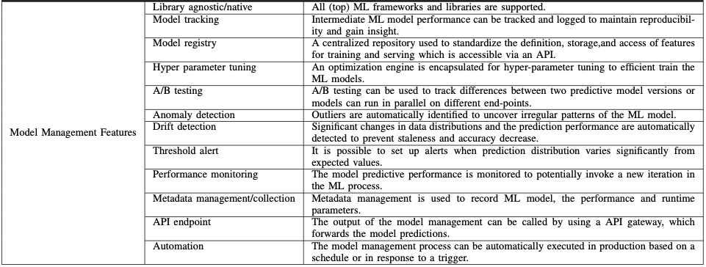
Also, Tools and features…

Slide 47
Recap
MLOps enables continuous delivery and deployment of ML models into production in a reliable and efficient way.
MLOps compasses a set of practices, processes, and technology capabilities.
We discussed MLOps Lifecyle and architecture.

Slide 48
An Extra Resource
Machine Learning in Production: From Models to Products
  https://ckaestne.medium.com/machine-learning-in-production-book-overview-63be62393581
  A book (online) based on a course, "Machine Learning in Production," at Carnegie Mellon University.

